Slide 1



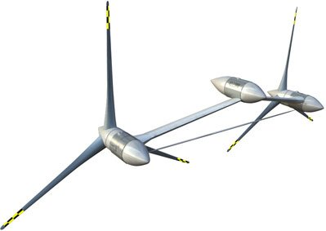
Concept Design Review
Aquantis C-Plane Ocean Energy Conversion
Dehlsen Associates LLC
Presented by
Naval Surface Warfare Center
Carderock Division
Rich Banko
3 - 4 May 2011

Slide 2
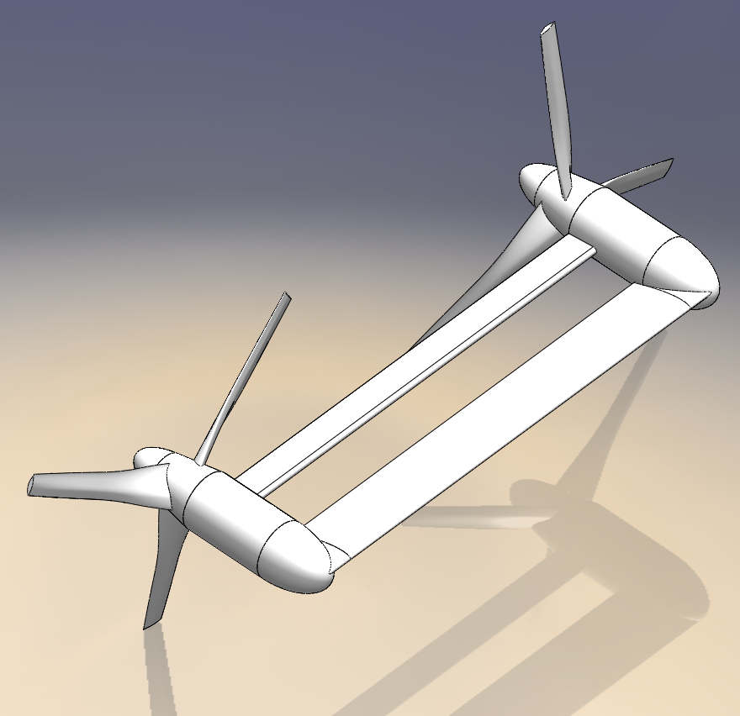
Notional Concept Analyzed for Vertical Plane Stability
Dehlsen Associates LLC
Nacelle
  Standard
Wing
  147 ft Span
  23 ft Cord
  12º Nose Up
Horizontal Fairing
  30 in Diameter Nose
  10 ft Cord
  147 ft Span
  Straight Taper to Trailing Edge

Slide 3
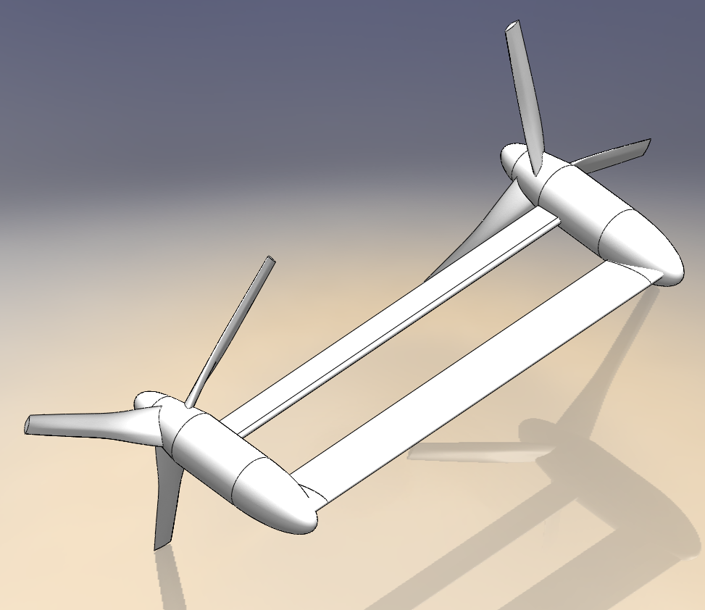
Alternate Concept with Longer Nose Cone
Dehlsen Associates LLC
Nacelle
  FWD Nose Extended to 30 ft
Wing
  147 ft Span
  23 ft Cord
  12º Nose Up
Horizontal Fairing
  30 in Diameter Nose
  10 ft Cord
  147 ft Span
  Straight Taper to Trailing Edge

Slide 4
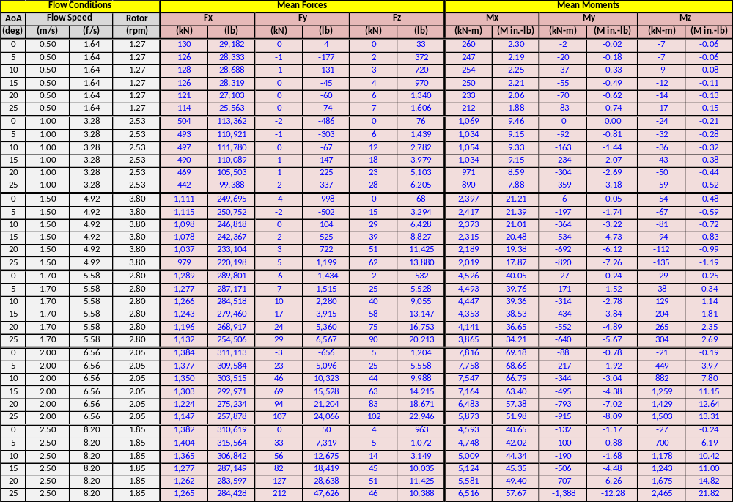
ARL Rotor & Nacelle CFD Data
Dehlsen Associates LLC

Slide 5
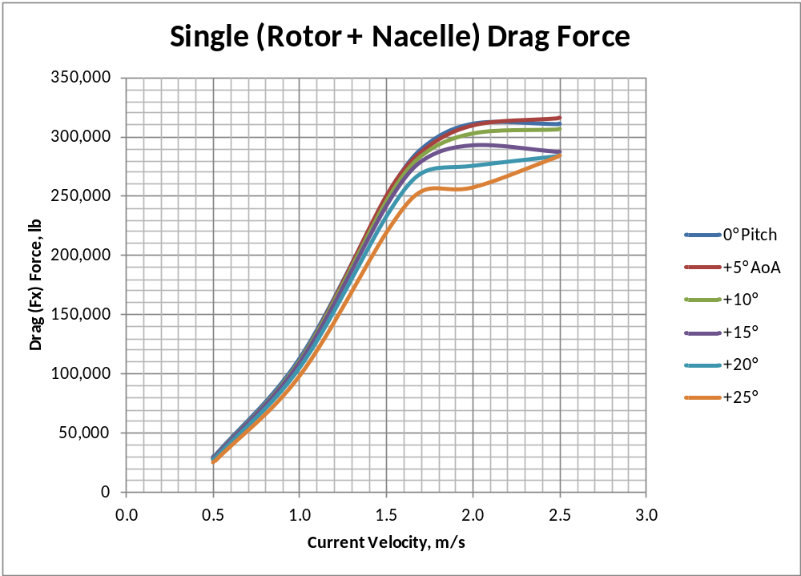
ARL Data Plots
Dehlsen Associates LLC

Slide 6
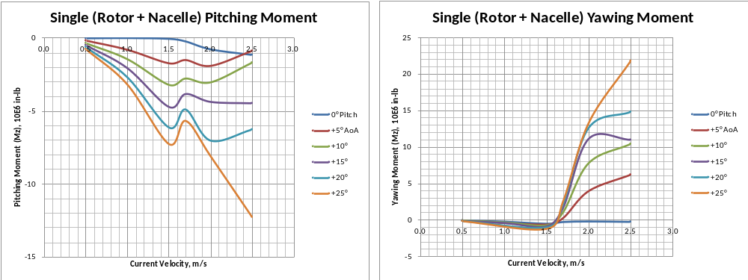
ARL Data Plots
Dehlsen Associates LLC
Rotor pitch moment vs. AoA (angle of attack) is negative, indicating stable configuration since the rotor is always tending to decrease its AoA and return to 0° pitch angle when perturbed. This characteristic is due to the rotor rake angle of 10°.
Rotor yawing moment due to pitch AoA goes negative to positive but will be nulled by the opposing rotor moment that will be opposite due to counter-rotation.

Slide 7
Summation of ARL Data for 2 Rotor System
Dehlsen Associates LLC
Using single rotor data to obtain 2-rotor forces and moments
Port rotor turns counterclockwise (ccw) and the starboard rotor turns clockwise (cw)
The combined forces in the 3 directions for 2-rotors are:
  FX tot = FX port rotor + FX stbd rotor = 2 x FX single rotor
  FY tot = FY port rotor – FY stbd rotor = 0
  FZ tot = FZ port rotor + FZ stbd rotor = 2 x FZ single rotor
The combined moments in the 3 directions for 2-rotors are:
  MX tot = MX port rotor - MX stbd rotor = 0
  MY tot = MY port rotor + MY stbd rotor = 2 x MY single rotor
  MZ tot = MZ port rotor - MZ stbd rotor = 0

Slide 8
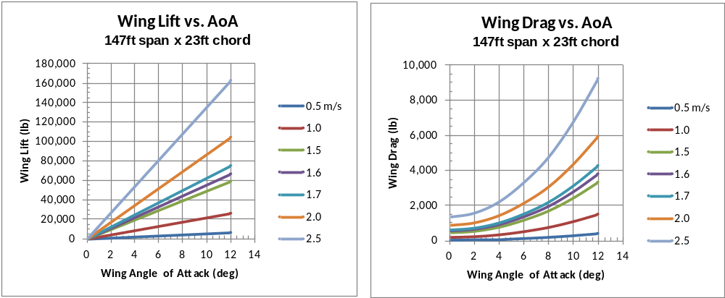
Wing Data
Dehlsen Associates LLC
Wing characteristics pertain to NACA 0018, 0020, 2418, 2421 type shapes
Aerodynamic center located at 25% chord, center of mass located at about 42% chord

Slide 9
Static Stability
Dehlsen Associates LLC
Static stability refers to the ability to react to static (weight & buoyancy) and steady hydrodynamic forces (rotor &wing) induced on the platform to seek a neutral and balanced attitude not resulting in increasing forces and moments
Three planes of static stability to consider:
  Vertical or pitch plane (forces in the z-direction, moments about the y-axis)
  Lateral or yaw plane (forces in the x-direction, moments about the z-axis)
  Horizontal or roll plane (forces in the y-direction, moments about the x-axis)
To date, vertical plane stability has only been investigated on a preliminary basis

Slide 10
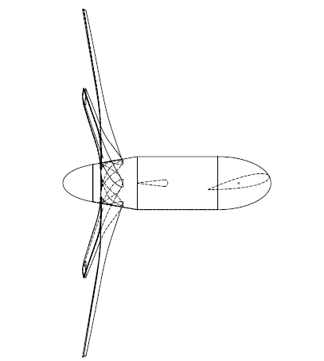

Vertical Plane Free Body Diagram
Dehlsen Associates LLC
Navy Coordinate System
X+
B_{N+R}
Y+
Z+
B_{W}
L_{W}
B_{T}
D_{N+R}
D_{W}
M_{y}
W_{W}
T_{ML}
W_{T}
W_{N+R}
Subscripts
N+R=Nacelle+Rotor Characteristics
W=Wing Characteristics
BT= FWD Buoyancy Trim Pod Characteristics
TW= AFT Trim Weight Characteristics

Slide 11
Vertical Plane (Pitch) Static Stability
Dehlsen Associates LLC
Developed a spreadsheet for summing the moments about the tow point location (positioned on the nacelle vertical centerline to avoid large induced moments by the rotor drag force)
An effective tow point located at the nose of the nacelles is unfeasible due to the large moments produced by the nacelle and wing buoyancy , and the increasing MY moment in the 1.5 to 2.5 m/s flow velocity range
Determined the location of the tow point for which all static and hydrodynamic moments balance for various platform net buoyancy (total displacement of sea water – air weight)
The larger the net buoyancy of the platform, the further aft the tow point must be located (may cause a problem with yaw stability)
Investigated using a forward located buoyancy pod (10,000 lb net buoyancy) and aft located counter-weight pod (10,000 lb heavy in sea water). Fwd & Aft Pods located 20ft or 30 ft ahead or aft of the nose or stern of the nacelle.

Slide 12
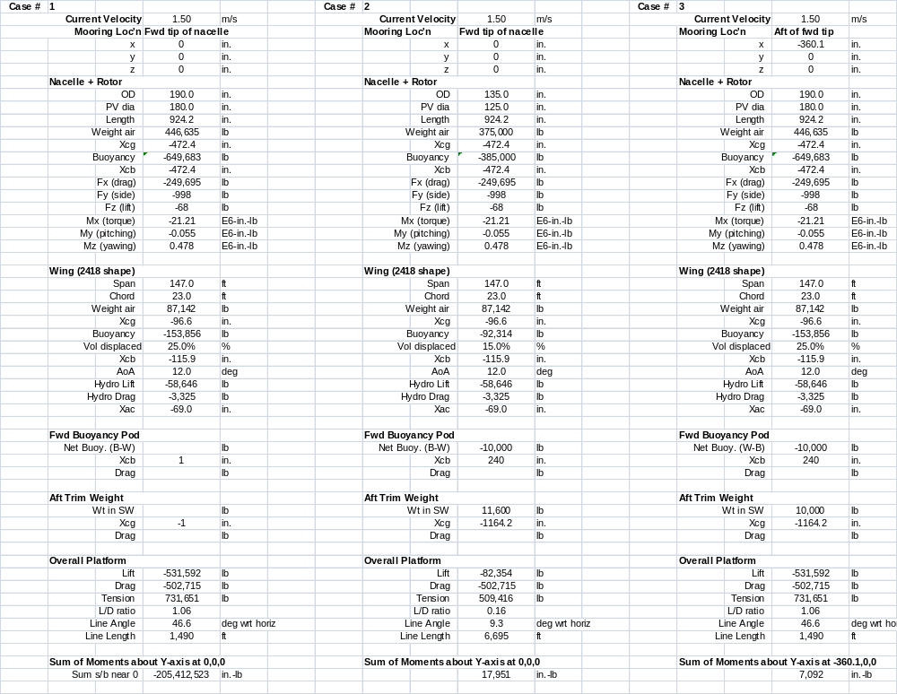
Stability Spreadsheet Results for 1.5 m/s Flow
Dehlsen Associates LLC

Slide 13
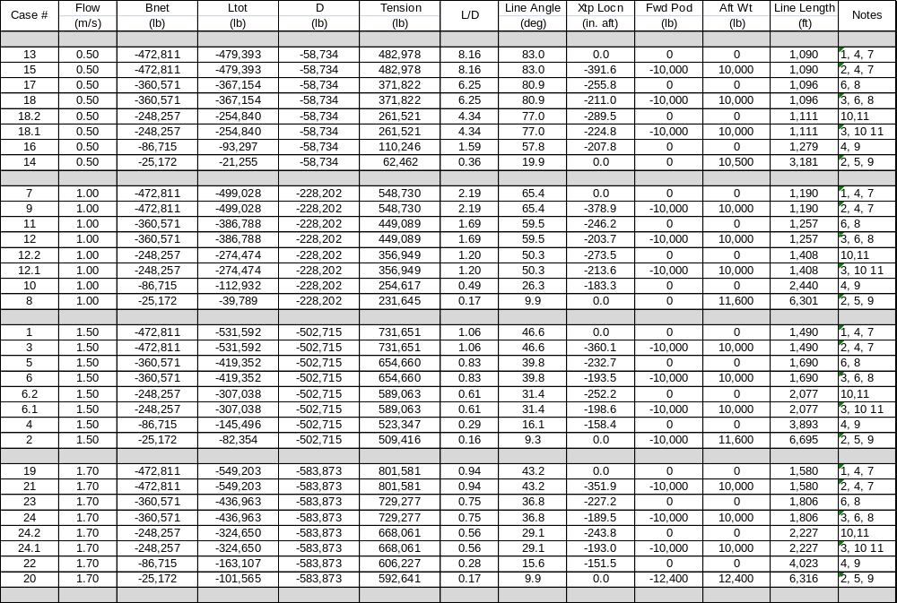
Summary of Vertical Plane Stability Analysis
Dehlsen Associates LLC

Slide 14
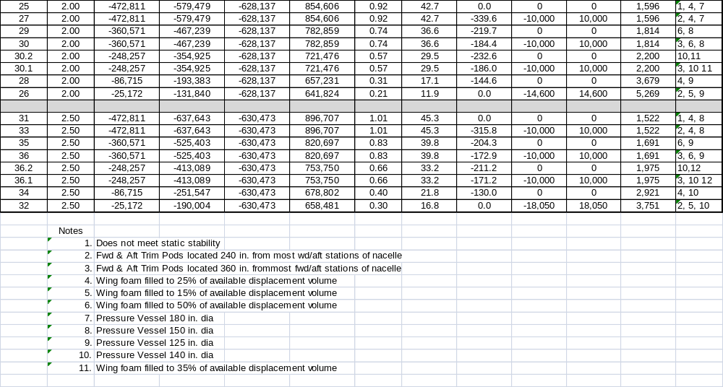
Summary of Vertical Plane Stability Analysis
Dehlsen Associates LLC

Slide 15
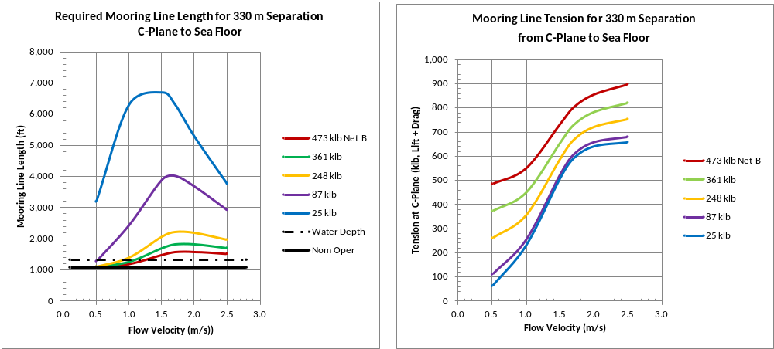
Mooring Line Length and Tension Results
Dehlsen Associates LLC
For platform net buoyancy in the range of 250 klb (1,100 kN) to 473 klb (2,100 kN) the mooring line length required (2,200ft or 670m) is quite flat for flow in the 1.5 to 2.5 m/s range

Slide 16
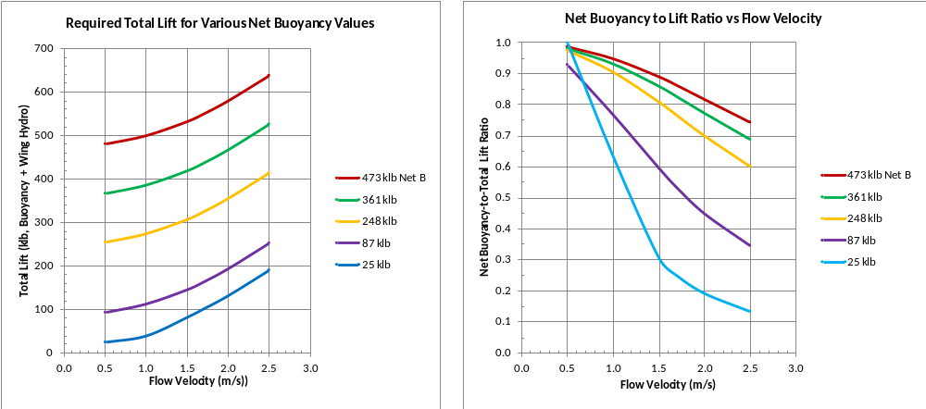
Required Platform Lift
Dehlsen Associates LLC
The required total lift force (net buoyancy + wing lift) required for stability varies with flow velocity to counter the speed increasing pitching moment of the rotor

Slide 17
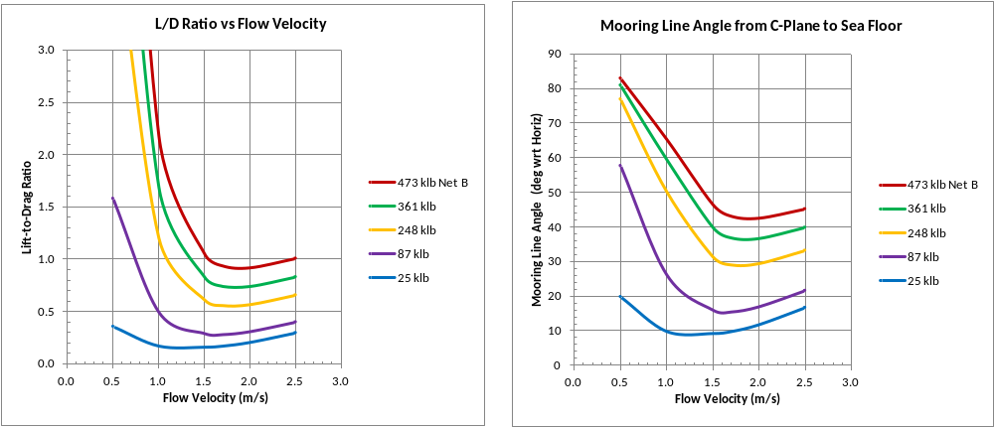
Platform L/D Ratio and Mooring Line Angle
Dehlsen Associates LLC
Platform Lift-to-Drag (L/D) ratio and mooring line angle wrt horizontal resulting from solving required stability moments
Mooring line angles in the range of 30° to 60° (L/D ratio 0.6 to 1.7, respectively) would be most desirable to reduce mooring line lengths

Slide 18
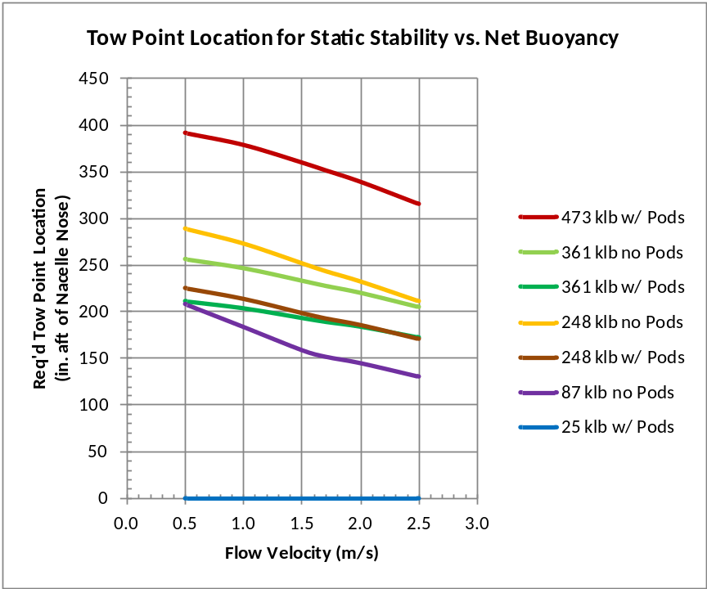
Required Tow Point Location for Stability
Dehlsen Associates LLC
Nacelle length: 925 in. (23.5m)
Trailing edge of wing: 276 in. (7.0m) aft of standard nacelle nose
Tow point variation: ± 25 in. (0.6m) from nominal operation location at 1.6 m/s flow

Slide 19
Dehlsen Associates LLC

Slide 20
Dehlsen Associates LLC

Slide 21
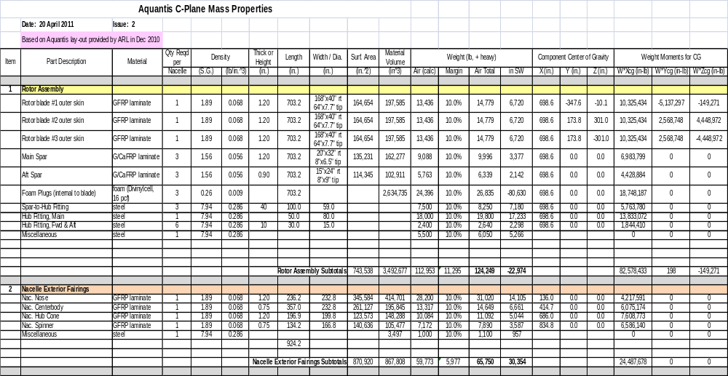
Estimated Weights & CG Locations for Major Components
Dehlsen Associates LLC
ARL Dec’10 Nacelle/Rotor configuration

Slide 22
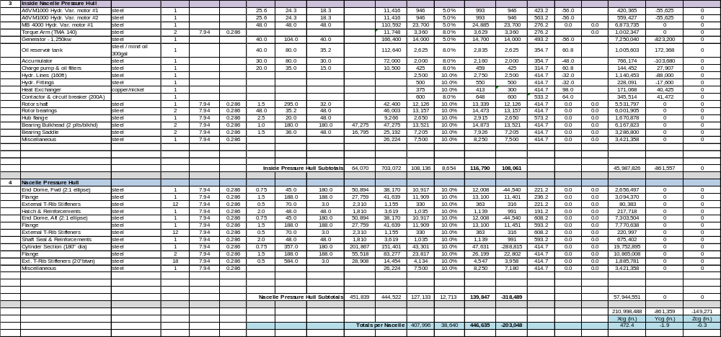
Estimated Weights & CG Locations for Major Components
Dehlsen Associates LLC

Slide 23
Estimated Weights & CG Locations for Major Components
Dehlsen Associates LLC
Based on ARL Dec’10 Nacelle/Rotor Configuration
Rotor Assembly:
  Length: 703 in. (17.9m);
  Root chord: 168 in. (4.27m); tip chord: 64 in. (1.63m)
  Wt: 124,200 lb air; -23,000 lb in sea water (SW) buoyant
Blades:
  Wt: 31,900 lb ea air; - 47,800 lb in sea water (SW) net buoyant
  Laminated carbon/glass fiber/vinyl ester resin spars & skins, foam filled interior to preclude water intrusion (imbalance)
  Tave = 1.20 in. (3.0cm)
Hub Fittings:
  Wt: 28,500 lb air; 25,000 lb in SW

Slide 24
Estimated Weights & CG Locations for Major Components
Dehlsen Associates LLC
Nacelle Exterior Fairings
  Length: 924 in. (23.47m); Outside Diameter: 236 in. (6.0m)
  Laminated glass fiber /vinyl ester resin
  Tave = 1.00 in. (2.5cm)
  Wt: 65,800 lb air: 30,400 lb in SW (heavy)
Drive train, shafting, bearings & hydraulic/electrical equipment internal to the pressure hull
  Wt: 116,800 lb air; 116,800 lb in SW (in housing, no displacement)
Pressure Hull (with external T-rib stiffeners)
  Diameter: 180 in. (4.57m)
  Length: 447 in. (11.35m)
  Wt: 139,850 lb air; -318,500 lb in SW (buoyant)

Slide 25
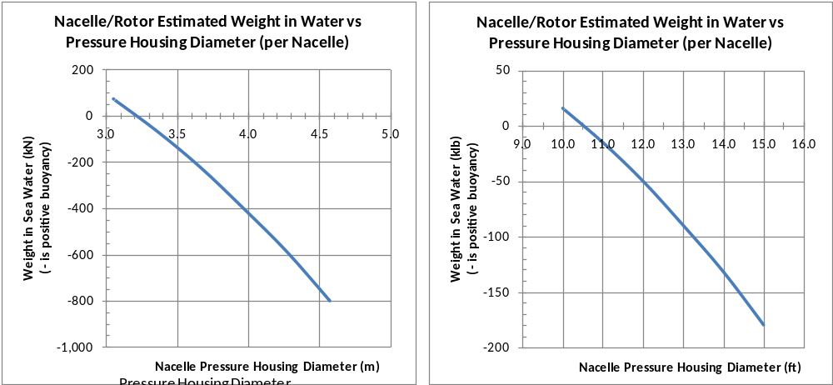
Pressure Hull Diameter vs. Weight in Sea Water
Dehlsen Associates LLC
Negative weight in sea water means positively buoyant (floats)
Housing length: 447 in. ( 11.35m)

Slide 26
Estimated Weights & CG Locations for Major Components
Dehlsen Associates LLC
Nacelle / Rotor Assembly
  Wt air: 446,600 lb (1,988 kN)
  Wt SW: - 194,300 lb (864 kN buoyant)
  Xcg: 472 in. (12.0m) aft of fwd end of nose
  Xcb: 472 in. (12.0m) aft of fwd end of nose (estimated same as CG)
  Zcg & Zcb have not been estimated at this time

Slide 27
Dehlsen Associates LLC

Slide 28
Dehlsen Associates LLC

Slide 29
Dehlsen Associates LLC

